Slide 1
小组会汇报2
房胜男
2018.10.24

Slide 2
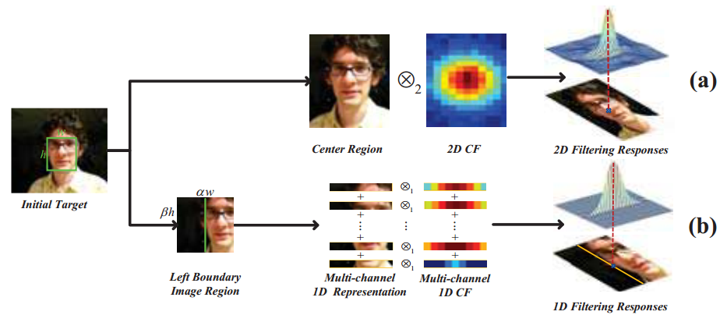
1、再探IBCCF（论文加代码阅读）
IBCCF: Feng Li, Yingjie Yao, Peihua Li, David Zhang, Wangmeng Zuo, Ming-Hsuan Yang. "Integrating Boundary and Center Correlation Filters for Visual Tracking With Aspect Ratio Variation." ICCV workshop (2017).
While several approaches have been proposed for scale adaptive tracking on CF-based trackers, the aspect ratio variation remains an open problem during tracking. IBCCF addresses this issue by introducing a family of 1D boundary CFs to localize the left, right, top, and bottom boundaries in videos.

Slide 3
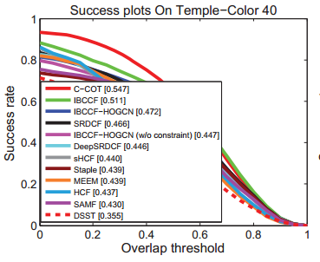
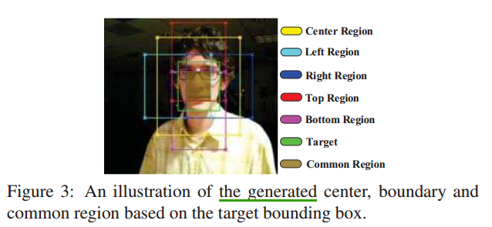
重新思考：
Center CF: (CCF)
和HCF类似：using the outputs of layers conv3-4, conv4-4 and conv5-4 of VGG-Net-19 for feature extraction，combine the responses from different layers, follow the HCF setting and assign the weights of three layers in the center CF to 0.02, 0.5 and 1. Boundary CFs :(BCF) 为什么要四个边？
omit the layer of conv3-4 and set the weights for layers of conv4-4 and conv5-4 both to 1. VS DSST:
In DSST, the 1D CF and 2D translation CF are separately trained. While in IBCCF, 1D BCFs and 2D CCF are jointly learned by solving the IBCCF model .（Near-orthogonality between Boundary and Center CFs ） KCF Vs ECO Features:
Temple-Color dataset: 128 color sequences. Different from the OTB dataset, it contain more video sequences with aspect ratio changes. In addition, for validating the effectiveness of IBCCF with hand-crafted features, we implement two variants of IBCCF with HOG and color name features.

Slide 4
2、其他论文
ECCV2018
UPDT: Goutam Bhat, Joakim Johnander, Martin Danelljan, Fahad Shahbaz Khan, Michael Felsberg. "Unveiling the Power of Deep Tracking." ECCV (2018). [paper]
DaSiamRPN: Zheng Zhu, Qiang Wang, Bo Li, Wu Wei, Junjie Yan, Weiming Hu. "Distractor-aware Siamese Networks for Visual Object Tracking." ECCV (2018). [paper] [github]
SACF: Mengdan Zhang, Qiang Wang, Junliang Xing, Jin Gao, Peixi Peng, Weiming Hu, Steve Maybank. "Visual Tracking via Spatially Aligned Correlation Filters Network." ECCV (2018). [paper]
RTINet: Yingjie Yao, Xiaohe Wu, Lei Zhang, Shiguang Shan, Wangmeng Zuo. "Joint Representation and Truncated Inference Learning for Correlation Filter based Tracking." ECCV (2018). [paper]
Meta-Tracker: Eunbyung Park, Alexander C. Berg. "Meta-Tracker: Fast and Robust Online Adaptation for Visual Object Trackers." [paper] [github]
DSLT: Xiankai Lu, Chao Ma*, Bingbing Ni, Xiaokang Yang, Ian Reid, Ming-Hsuan Yang. "Deep Regression Tracking with Shrinkage Loss." ECCV (2018). [paper] [github]
DRL-IS: Liangliang Ren, Xin Yuan, Jiwen Lu, Ming Yang, Jie Zhou. "Deep Reinforcement Learning with Iterative Shift for Visual Tracking." ECCV (2018). [paper]
RT-MDNet: Ilchae Jung, Jeany Son, Mooyeol Baek, Bohyung Han. "Real-Time MDNet." ECCV (2018). [paper]
ACT: Boyu Chen, Dong Wang, Peixia Li, Huchuan Lu. "Real-time 'Actor-Critic' Tracking." ECCV (2018). [paper] [github]
StructSiam: Yunhua Zhang, Lijun Wang, Dong Wang, Mengyang Feng, Huchuan Lu, Jinqing Qi. "Structured Siamese Network for Real-Time Visual Tracking." ECCV (2018). [paper]
MemTrack: Tianyu Yang, Antoni B. Chan. "Learning Dynamic Memory Networks for Object Tracking." ECCV (2018). [paper]
SiamFC-tri: Xingping Dong, Jianbing Shen. "Triplet Loss in Siamese Network for Object Tracking." ECCV (2018). [paper] [github]

Slide 5
CVPR2018
VITAL: Yibing Song, Chao Ma, Xiaohe Wu, Lijun Gong, Linchao Bao, Wangmeng Zuo, Chunhua Shen, Rynson Lau, Ming-Hsuan Yang. "VITAL: VIsual Tracking via Adversarial Learning." CVPR (2018 Spotlight). [project] [paper] [github]
LSART: Chong Sun, Dong Wang, Huchuan Lu, Ming-Hsuan Yang. "Learning Spatial-Aware Regressions for Visual Tracking." CVPR (2018 Spotlight). [paper]
SiamRPN: Bo Li, Wei Wu, Zheng Zhu, Junjie Yan. "High Performance Visual Tracking with Siamese Region Proposal Network." CVPR (2018 Spotlight). [paper]
TRACA: Jongwon Choi, Hyung Jin Chang, Tobias Fischer, Sangdoo Yun, Kyuewang Lee, Jiyeoup Jeong, Yiannis Demiris, Jin Young Choi. "Context-aware Deep Feature Compression for High-speed Visual Tracking." CVPR (2018). [project] [paper]
RASNet: Qiang Wang, Zhu Teng, Junliang Xing, Jin Gao, Weiming Hu, Stephen Maybank. "Learning Attentions: Residual Attentional Siamese Network for High Performance Online Visual Tracking." CVPR 2018. [paper]
SA-Siam: Anfeng He, Chong Luo, Xinmei Tian, Wenjun Zeng. "A Twofold Siamese Network for Real-Time Object Tracking." CVPR (2018). [paper]
STRCF: Feng Li, Cheng Tian, Wangmeng Zuo, Lei Zhang, Ming-Hsuan Yang. "Learning Spatial-Temporal Regularized Correlation Filters for Visual Tracking." CVPR (2018). [paper] [github]
FlowTrack: Zheng Zhu, Wei Wu, Wei Zou, Junjie Yan. "End-to-end Flow Correlation Tracking with Spatial-temporal Attention." CVPR (2018). [paper]
DEDT: Kourosh Meshgi, Shigeyuki Oba, Shin Ishii. "Efficient Diverse Ensemble for Discriminative Co-Tracking." CVPR (2018). [paper]
SINT++: Xiao Wang, Chenglong Li, Bin Luo, Jin Tang. "SINT++: Robust Visual Tracking via Adversarial Positive Instance Generation." CVPR (2018). [paper]
DRT: Chong Sun, Dong Wang, Huchuan Lu, Ming-Hsuan Yang. "Correlation Tracking via Joint Discrimination and Reliability Learning." CVPR (2018). [paper]
MCCT: Ning Wang, Wengang Zhou, Qi Tian, Richang Hong, Meng Wang, Houqiang Li. "Multi-Cue Correlation Filters for Robust Visual Tracking." CVPR (2018). [paper] [github]
MKCF: Ming Tang, Bin Yu, Fan Zhang, Jinqiao Wang. "High-speed Tracking with Multi-kernel Correlation Filters." CVPR (2018). [paper]
HP: Xingping Dong, Jianbing Shen, Wenguan Wang, Yu, Liu, Ling Shao, and Fatih Porikli. "Hyperparameter Optimization for Tracking with Continuous Deep Q-Learning." CVPR (2018). [paper]

